Slide 1

DATA-DRIVEN ENERGY INSIGHTS
From Sunlight to Socket
Data-Driven Insights into Solar Production and Consumption
This project brings together real solar production data from homes in Kerala and energy consumption data from households in Delhi. Using machine learning, it explores patterns in solar panel performance and how climate factors affect energy use

Slide 2






Abstract & Project Objectives
This project explores the relationship between climate variables and solar energy production while analyzing household electricity consumption patterns to enable smarter energy planning.
Project Objectives
Key Objectives
Predict solar energy production
Using climate data integration and machine learning models
Analyze consumption patterns
Decode household electricity usage behavior and trends
Predict Solar Production
Using climate data to forecast daily solar output
Develop AI-powered forecasting
Build models for accurate energy prediction and planning
Analyze Consumption
Uncovering patterns in household electricity usage
Create future applications
Web platform and virtual assistant for energy awareness
ML Model Comparison
ARIMAX vs. Prophet vs. Optimized LSTM
Key Challenges
☁ Climate-dependent solar production
⏱ Unpredictable household consumption patterns
🔄 Bridging production and consumption insights

Slide 3




Dataset Overview
Two complementary datasets capturing energy production and consumption patterns
Solar Production Dataset
Consumption Dataset
Location
Malappuram, Kerala
Location
Residential Household, Delhi
Lat: 11°11′53.58″
Long: 76°20′7.34″
High-resolution smart meter data
Kerala
Delhi
Time Period
February 15, 2023 - April 30, 2025
Time Resolution
Sub-minute intervals (milliseconds)
Timestamps converted: UTC → IST
Data Sources
Household On-Grid Solar System
NASA POWER Climate Data
Data Source
Smart Energy Monitoring System
Key Variables
Key Variables
Production-Today (kWh) Solar Irradiance Temperature (2m)
Humidity (2m) Precipitation Wind Speed (10m)
Current Voltage
Power (W) Cumulative Energy Frequency
Apparent Power Reactive Power Power Factor
Data Integration: The production dataset was merged with NASA climate data using the date as the common key. Consumption data was analyzed independently with enhanced time-based insights.
3

Slide 4

Data Preprocessing & Feature Engineering
Raw Data
Solar production, climate, & consumption logs
Data Cleaning
Missing values, duplicate removal, timestamps
Feature Engineering
Weather labels, time features, seasonal context
Integration
Merging datasets, aligning timestamps
ML-Ready Data
Clean, structured datasets for modeling
Solar Production Preprocessing
Consumption Data Preprocessing
Missing Value Handling
Replaced NASA's placeholder values (-999) with NaN, then applied interpolation techniques to fill gaps
Timestamp Conversion
Converted UTC timestamps to IST (Indian Standard Time) for better alignment with local context
Weather Labeling
Created qualitative weather labels ("Hot & Sunny", "Rainy", etc.) from climate parameters
Time-Based Features
Extracted hour, day, weekday, IsWeekend, partOfDay (Morning/Afternoon/Evening/Night) from timestamps
Seasonal Context
Added Indian weather seasons (Summer, Monsoon, Post-Monsoon, Winter) to analyze seasonal impact
Column Simplification
Renamed complex column names from automated logging to more intuitive, shorter names
Key Transformation:
NASA climate data + local solar readings merged on date column to create a comprehensive dataset
ML-Ready Features:
Voltage Current Power Time of Day Weekday/Weekend
4

Slide 5
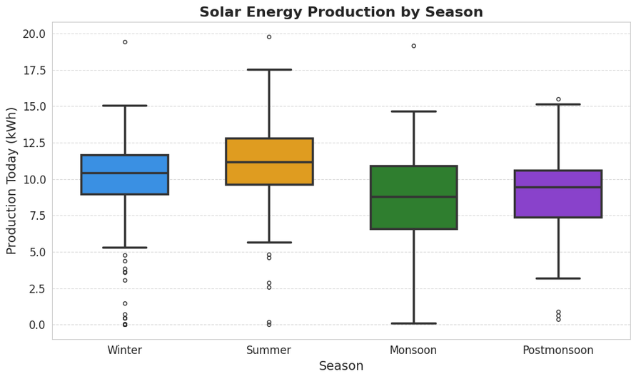
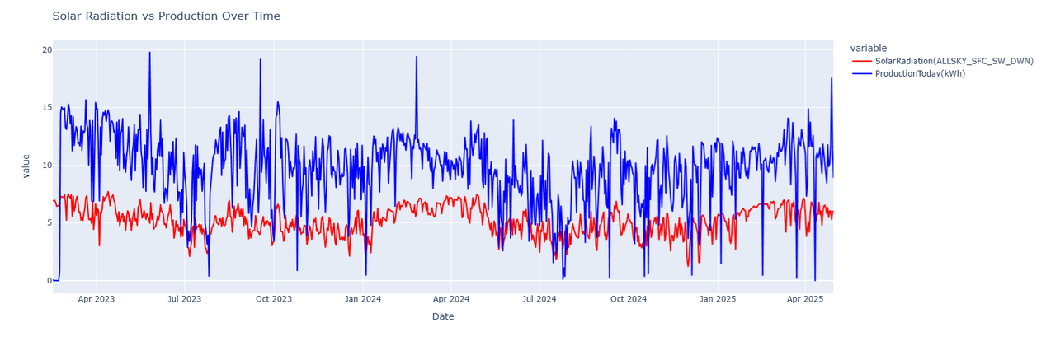
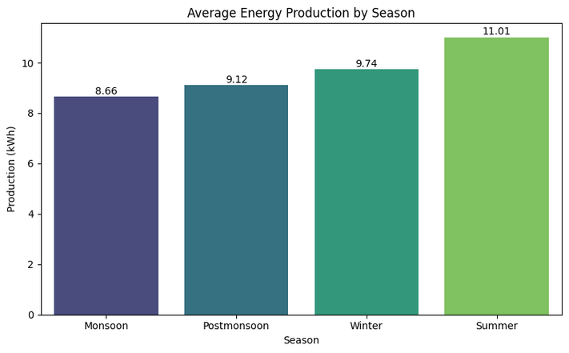
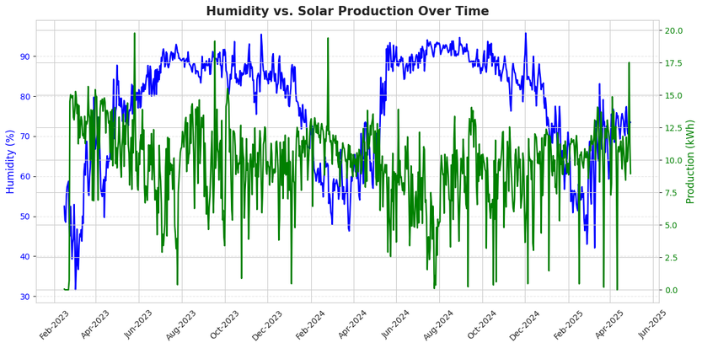
Solar Production Dataset Analysis (Kerala)
Solar Production Patterns

Slide 6
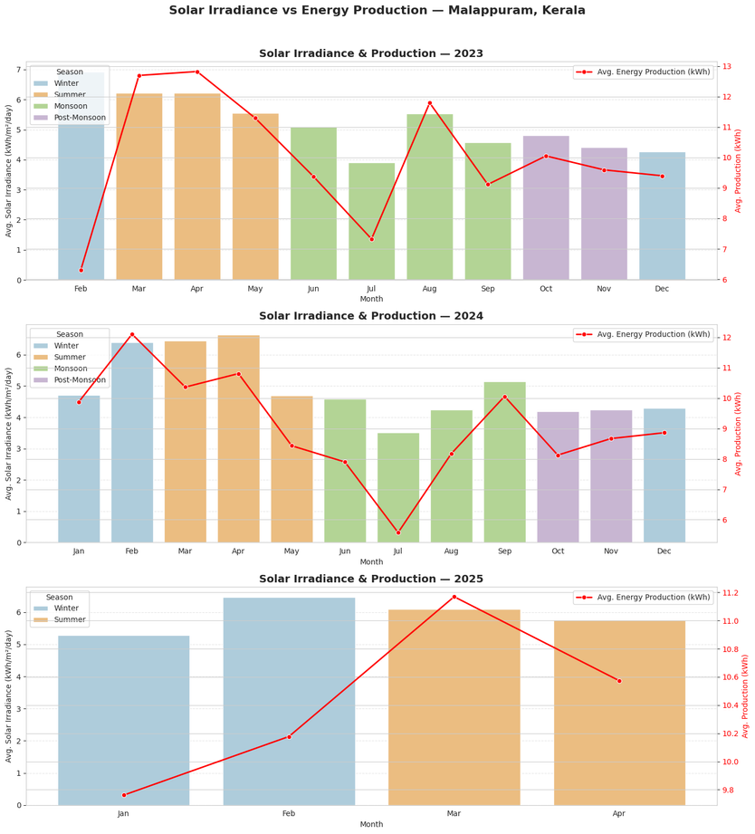
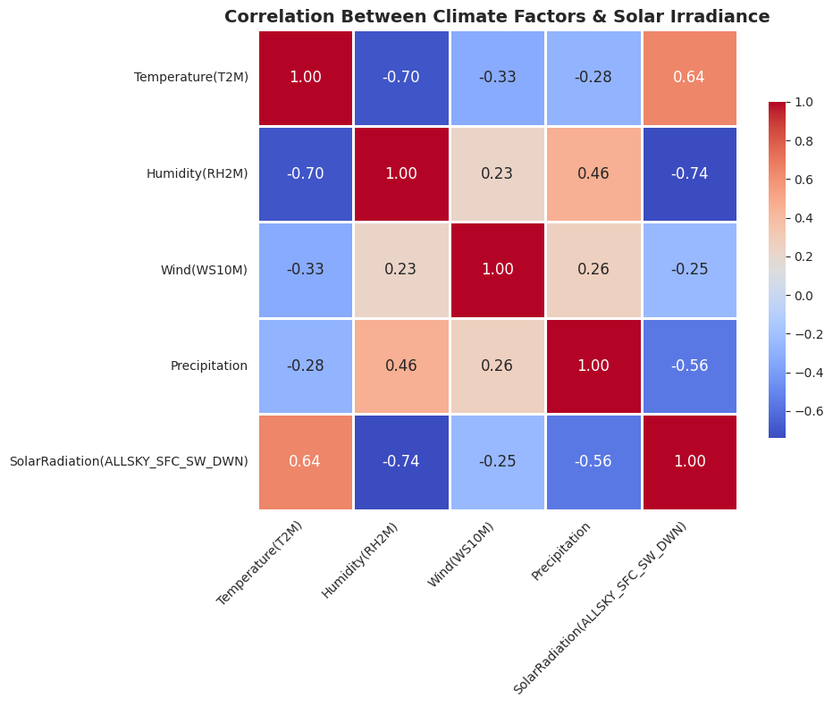
Solar Production Dataset Analysis (Kerala)
Solar Production Patterns

Slide 7
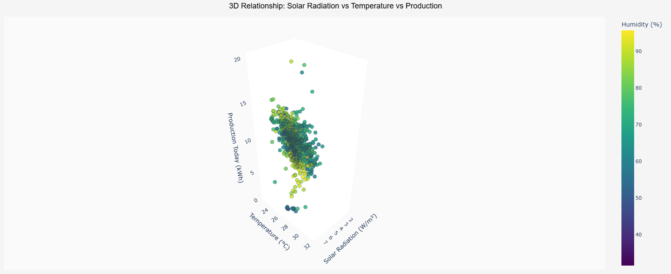
Solar Production Dataset Analysis (Kerala)
Solar Production Patterns

Slide 8
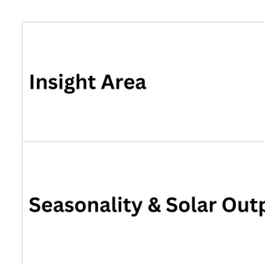

Solar Production Dataset Analysis (Kerala)
Analysis of solar production data from Malappuram, Kerala (Feb 2023–Apr 2025) reveals strong relationships between climate variables and energy output.
Key Seasonal Patterns
Summer Peaks
Highest production during summer months (Mar-May)
Monsoon Depression
Lowest output during monsoon season (Jun-Sep)
Post-Monsoon Recovery
Strong production rebounds after rainy season ends
Climate Impact Factors
Temperature
Solar Radiation
Humidity
Wind Speed
Negative correlation

Slide 9
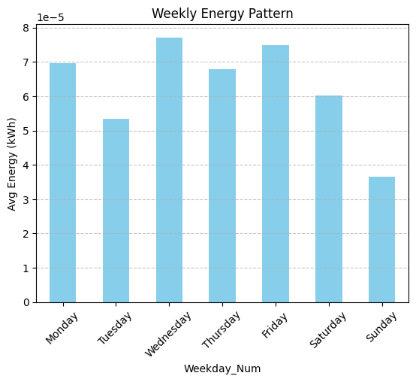
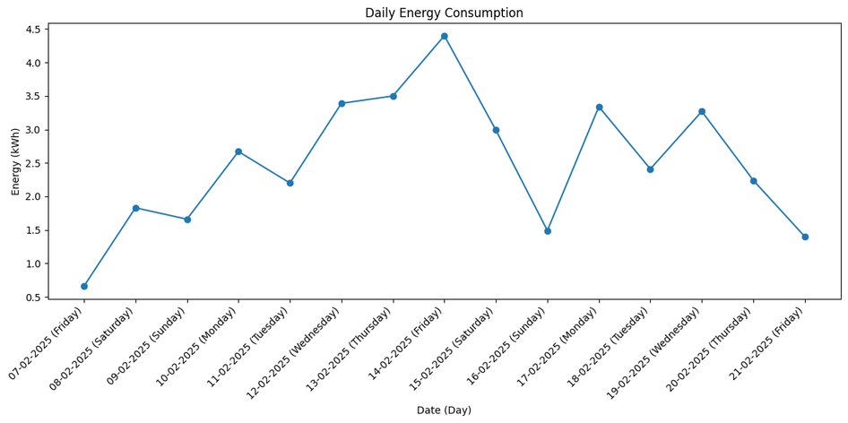
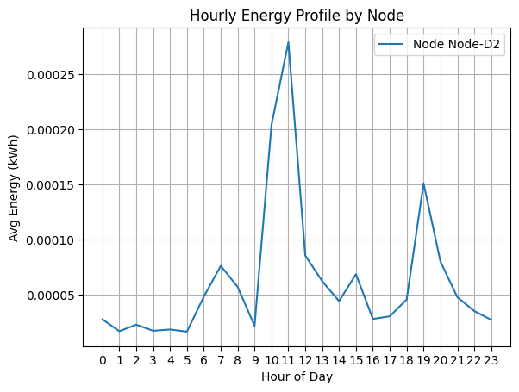
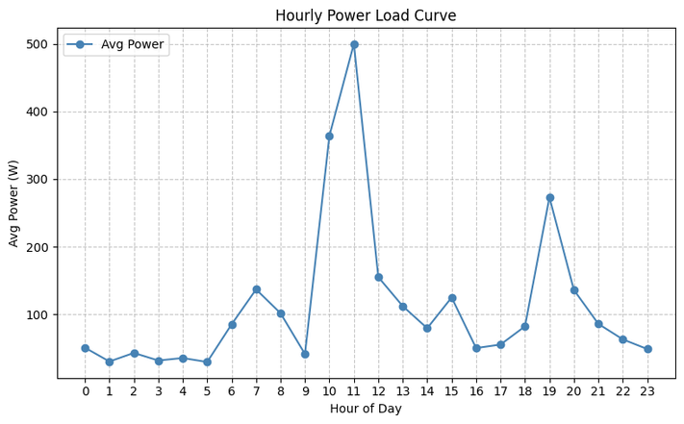
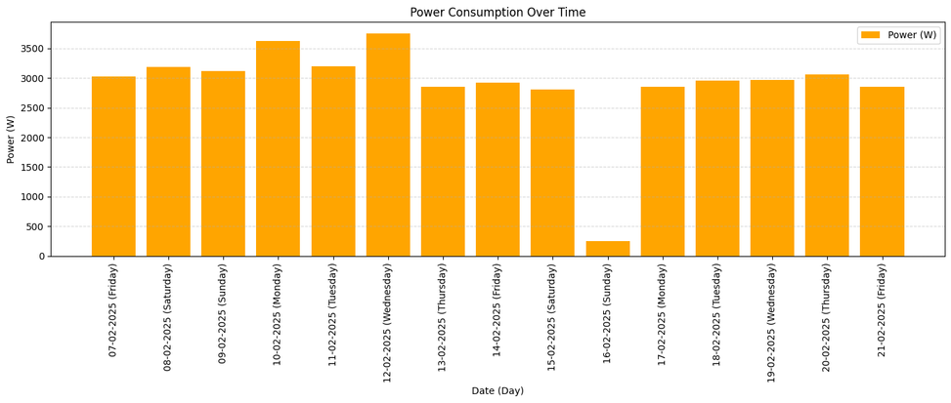
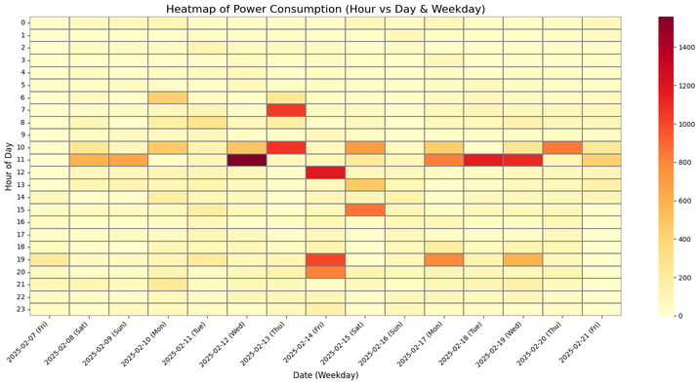
Household Consumption Dataset Analysis (Delhi)
Consumption Pattern

Slide 10
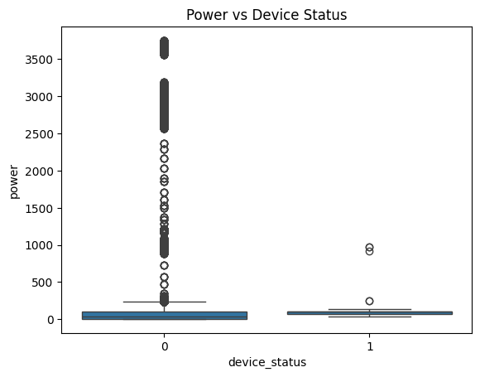
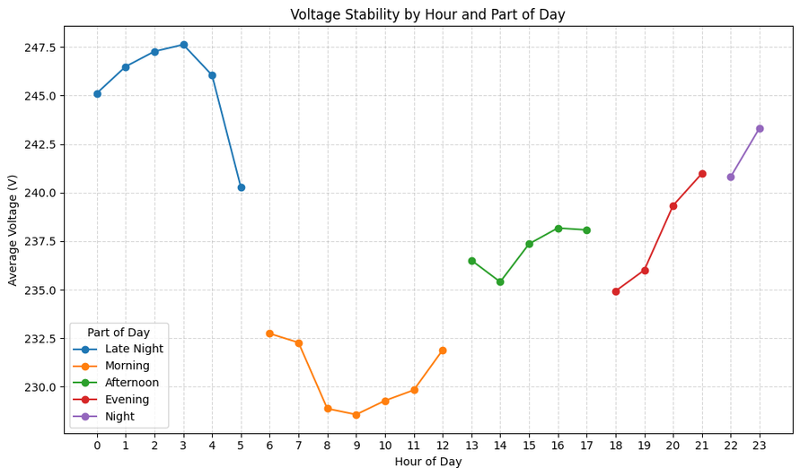
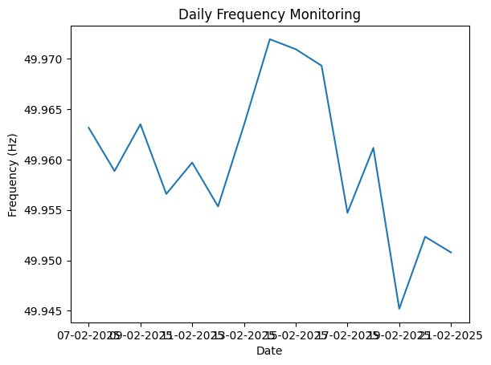
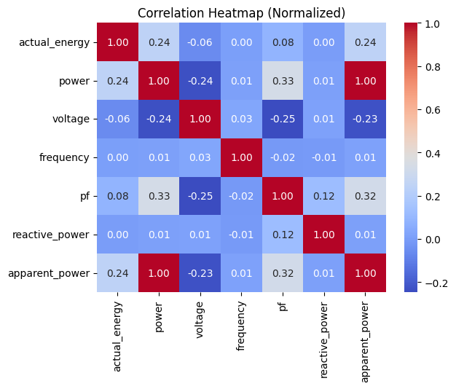
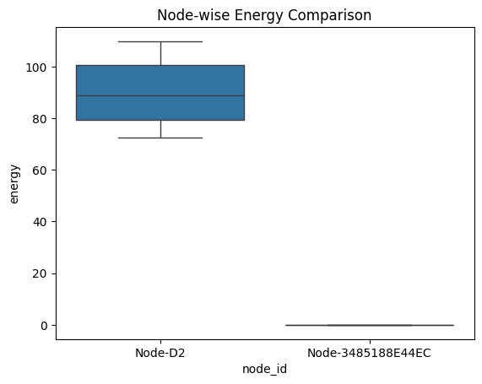
Household Consumption Dataset Analysis (Delhi)
Consumption Pattern

Slide 11
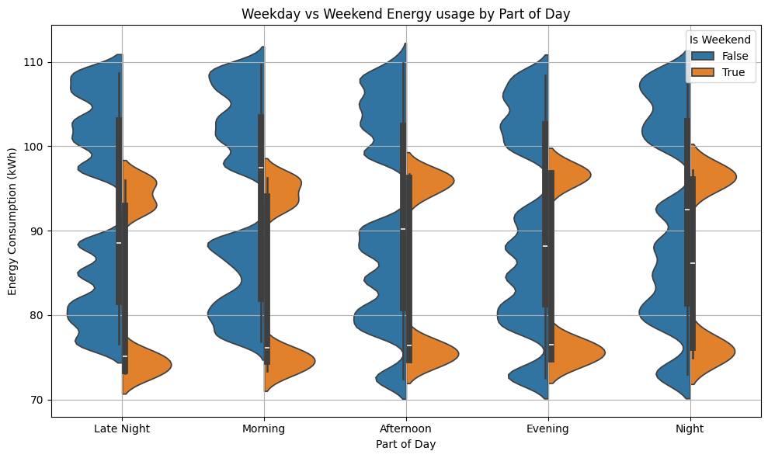
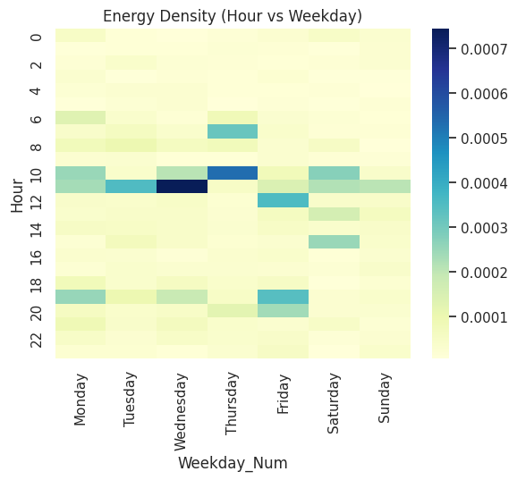
Household Consumption Dataset Analysis (Delhi)
Consumption Pattern

Slide 12

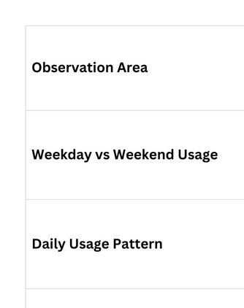
Consumption Dataset Analysis
Analysis of smart meter data from a Delhi household revealed distinct patterns in electricity usage across different times and days, with clear behavioral insights.
Key Findings
Weekday vs Weekend Patterns
Higher consumption on weekdays (especially Thu-Fri), with notable drops on weekends
Daily Usage Cycles
Distinct morning and evening peaks during active household hours
Power Quality Insights
Stable voltage (~240V) with minor dips during high-demand periods
Energy Efficiency
High-consumption devices show better power factor values, indicating more efficient usage
Dataset includes high-frequency readings of current, voltage, power,
frequency, and other electrical parameters, converted from UTC to IST.

Slide 13








Machine Learning Models Comparison - Solar Production
ARIMAX
Prophet
Multivariate LSTM
Statistical Time Series
Decomposable Forecasting
Approach
Deep Learning
Approach
Approach
Autoregressive Integrated Moving Average with eXogenous variables. Captures linear relationships and seasonal patterns.
Decomposition of trends, seasonality, and holidays with added weather regressors. Developed by Meta for business forecasting.
Long Short-Term Memory network capable of learning complex non-linear patterns from multiple variables simultaneously.
Strengths
Strengths
Strengths
Interpretable results Statistical confidence intervals Good for linear trends
RMSE: 3.077 kWh
Handles missing data well Automatic seasonality detection Robust to outliers
RMSE: 3.209 kWh
Captures complex patterns Learns temporal dependencies Best overall performance RMSE: 2.55 kWh (optimized)
Implementation
Implementation
Implementation
statsmodels.tsa.arima.model Parameters tuned via AIC
prophet library
Daily/yearly seasonality enabled
tensorflow.keras
3 LSTM layers with dropout
Evaluation Methodology
Data Split: 85% training, 15% testing
Time Window: April 1 - May 1, 2025
Metrics: RMSE, MAE
Best Model: Optimized LSTM
Features: Solar radiation, temperature, humidity, precipitation, wind

Slide 14

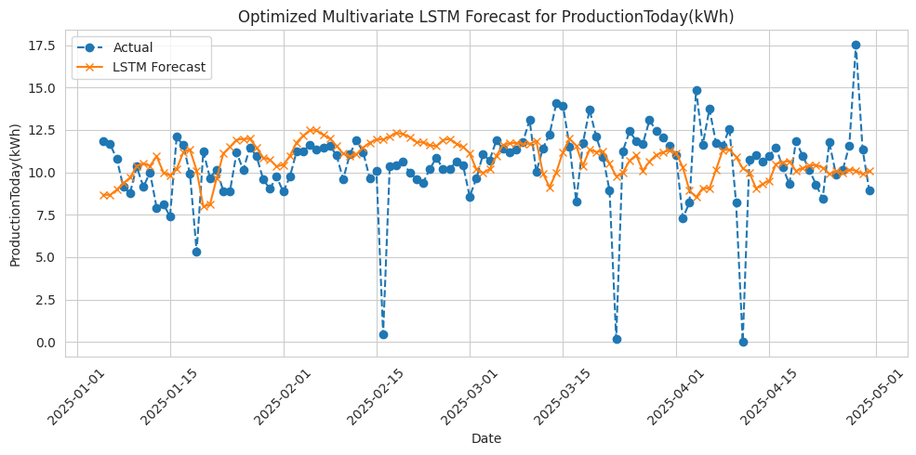







Solar Production Forecasting Results
Model Performance Comparison
MODEL | RMSE (KWH) | MAE (KWH) | RANK
ARIMAX | 3.077 | 1.940 | 3rd
Prophet with Regressors | 3.209 | 2.031 | 4th
Multivariate LSTM | 2.825 | 2.021 | 2nd
Optimized LSTM | 2.550 | 1.750 | 1st
Key Achievements
Optimized LSTM improved performance by ~10% in RMSE and ~13% in MAE over baseline models
Successfully captured production trends and predicted extreme events like the April 10th shutdown
ARIMAX
Strong with linear trends, good stability, computationally efficient
Prophet
Handles seasonality well, robust to missing data, but less accurate overall
Deep learning approaches showed better capability in handling non-linear patterns and volatility
Multivariate LSTM
Captures complex patterns and dependencies across multiple variables
Optimized LSTM
Best overall performance with optimized hyperparameters
Made with Genspark
Test period: April 1 - May 1, 2025

Slide 15





Machine Learning Methodology Comparison - Consumption
Consumption Analysis
LSTM for Consumption
Multivariate time-series forecasting on smart meter data
Training Configuration
Optimizer
Adam (learning rate: 0.001)
Loss Function
Mean Squared Error (MSE)
Model Architecture:
Input (8 features, 15 timesteps)
Batch Size 16
Epochs
50 with early stopping
LSTM Layer (64 units, ReLU)
Validation
15% of data, time-based split
Normalization MinMaxScaler per feature
Dropout (0.2)
LSTM Layer (32 units, ReLU)
Insight
Deep learning models outperformed classical statistical approaches for both datasets, particularly for capturing non-linear relationships between climate variables and energy patterns.
Dropout (0.2)
Insight
Deep learning models outperformed classical statistical approaches for both datasets, particularly for capturing non-linear relationships between climate variables and energy patterns.
Dense Output (1 unit, linear)
Made with Genspark
6

Slide 16


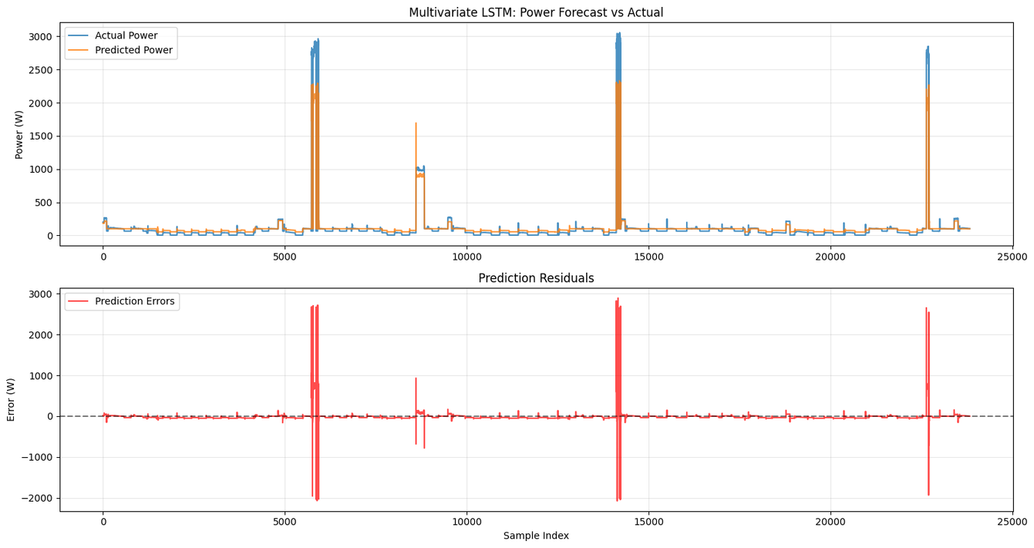

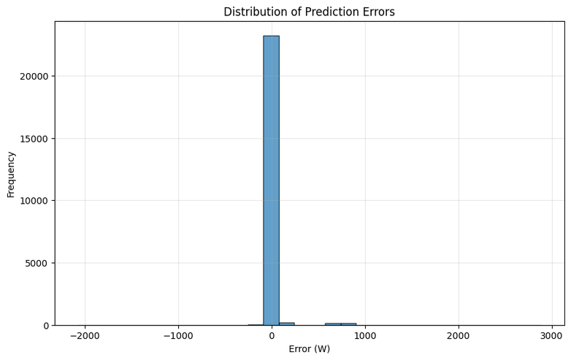
Household Consumption Prediction Results
LSTM Model Performance
Mean Absolute Error
40.98 W
Average absolute difference between predicted and actual values
Root Mean Square Error
115.52 W
Standard deviation of prediction errors
R² Score
0.88
Proportion of variance explained by the model
Mean Power (Test Set)
109.52 W
Average consumption level in the test dataset
Key Capabilities
Accurate prediction of daily routine consumption patterns
Effective capture of major consumption spikes up to 3000W
Consistent performance across different usage scenarios
Day-ahead household load forecasting
Peak demand management and shifting
Battery storage optimization
Time-of-use tariff planning
Made with Genspark
From Sunlight to Socket: Data-Driven Energy Insights

Slide 17








Conclusion & Broader Impact
Project Contributions
Key Findings
Strong correlations between climate and solar production. Distinct consumption patterns based on time, day, and voltage stability. Machine learning models accurately predict energy generation and usage.
Implications
Data from sensors and weather sources can help households anticipate energy behaviour, leading to informed decisions and reduced grid dependency. Provides a scalable framework for integrating renewable energy.
Future Enhancements
Incorporate real-time IoT feedback, expand datasets for regional variations, develop hybrid models, and integrate into a live dashboard and virtual assistant for daily energy insights.
Broader Impact
🌿 Environmental Sustainability
Optimized solar utilization reduces carbon footprint and dependency on fossil fuels, directly contributing to climate action goals
💰 Economic Benefits
Better forecasting and usage patterns can lead to cost savings, optimal energy trading, and reduced waste
💡 User Empowerment
Predictive insights enable households to make informed decisions about energy usage, storage, and grid interaction
🔍 Research Applications
Methodology demonstrated can be applied to other locations and refined for specialized scenarios
From Data to Action
This project demonstrates how machine learning and data science can transform renewable energy from an intermittent resource into a predictable, manageable part of our energy future.
Contact: research@example.com GitHub: github.com/solar-ml-project
Made with Genspark
12

Slide 18
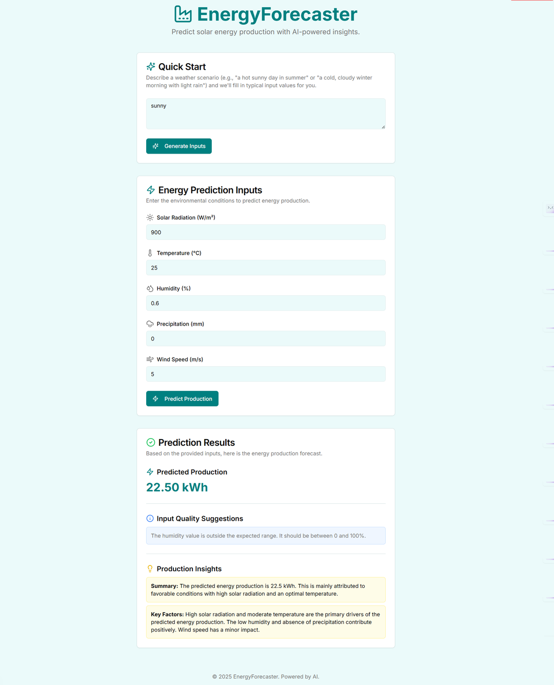



Future Applications
Building on our predictive models and insights, we propose two user-centric digital solutions to make energy intelligence accessible to all users.
Web Dashboard
Virtual Assistant
Interactive forecasting, visualization, and energy planning tools for users.
Voice-powered energy insights: "How much energy will I produce tomorrow?"
IoT Integration
Anomaly Detection
Connect smart meters, panels, and home devices for real-time monitoring.
Automatically identify unusual patterns, equipment issues, or failures.
Carbon Tracking
Mobile App
Calculate CO₂ savings and environmental impact of solar adoption.
On-the-go energy monitoring, alerts, and usage optimization.
Development Roadmap
1
2
3
4
Prototype Q3 2025
Beta Release Q4 2025
IoT Integration Q1 2026
Public Launch Q3 2026
Made with Genspark
From Sunlight to Socket: Data-Driven Energy Insights

Slide 19





Thank You
Acknowledgements
NASA POWER DAV
For providing accessible solar and meteorological data
Open Source Community
TensorFlow, scikit-learn, Prophet, and other tools that made this work possible
Questions? We'd love to hear from you!
Questions? We'd love to hear from you!
From Sunlight to Socket: Data-Driven Energy Insights
June 17, 2025
Made with Genspark

